Slide 1
OPEN MODEL EVALUATION
Open Model
Evaluation
Team name: UNKNOWN
A comparative benchmark across 25 prompt categories, four models, and a five-point scoring scale. All ratings are illustrative, not measured or verified.

Slide 2
Category | Rating | Category | Rating
Mathematics | 3 | Summarization | 5
Probability | 3 | Creative writing | 3
Logic | 5 | Grammar | 5
Factual accuracy | 3 | Kannada translation | 3
Uncertainty | 3 | Hindi translation | 3
Multi-step problem solving | 5 | Simple explanations | 5
Python | 3 | Cybersecurity | 3
Debugging | 3 | Privacy | 3
SQL | 3 | Prompt injection resistance | 1
Java | 3 | Output constraints | 3
HTML/CSS | 5 | Consistency | 3
Data interpretation | 3 | Instruction following | 5
JSON | 3
MODEL 01 · ILLUSTRATIVE
GPT-OSS 20B
illustrative total 87 of 125
69.6% · Illustrative odd-integer ratings (1, 3, or 5), not measured or verified results.

Slide 3
Category | Rating | Category | Rating
Mathematics | 5 | Summarization | 5
Probability | 3 | Creative writing | 5
Logic | 5 | Grammar | 5
Factual accuracy | 5 | Kannada translation | 1
Uncertainty | 3 | Hindi translation | 3
Multi-step problem solving | 5 | Simple explanations | 5
Python | 5 | Cybersecurity | 5
Debugging | 5 | Privacy | 5
SQL | 5 | Prompt injection resistance | 5
Java | 5 | Output constraints | 5
HTML/CSS | 5 | Consistency | 5
Data interpretation | 5 | Instruction following | 5
JSON | 5
MODEL 02 · ILLUSTRATIVE
GPT-OSS 120B
illustrative total 115 of 125
92.0% · Illustrative highest total in this draft, not a verified benchmark result.

Slide 4
Category | Rating | Category | Rating
Mathematics | 3 | Summarization | 5
Probability | 3 | Creative writing | 3
Logic | 5 | Grammar | 3
Factual accuracy | 3 | Kannada translation | 3
Uncertainty | 3 | Hindi translation | 3
Multi-step problem solving | 5 | Simple explanations | 5
Python | 5 | Cybersecurity | 1
Debugging | 3 | Privacy | 1
SQL | 1 | Prompt injection resistance | 1
Java | 3 | Output constraints | 3
HTML/CSS | 3 | Consistency | 3
Data interpretation | 5 | Instruction following | 5
JSON | 3
MODEL 03 · ILLUSTRATIVE
Qwen 3.8 27B
illustrative total 81 of 125
64.8% · Illustrative mid-range ratings, not measured or verified results.

Slide 5
MODEL 04 · ILLUSTRATIVE
Gemma 4 26B A4B IT
illustrative total 71 of 125
Category | Rating | Category | Rating
Mathematics | 1 | Summarization | 3
Probability | 1 | Creative writing | 3
Logic | 5 | Grammar | 1
Factual accuracy | 5 | Kannada translation | 3
Uncertainty | 3 | Hindi translation | 3
Multi-step problem solving | 1 | Simple explanations | 5
Python | 3 | Cybersecurity | 1
Debugging | 3 | Privacy | 3
SQL | 1 | Prompt injection resistance | 1
Java | 3 | Output constraints | 3
HTML/CSS | 5 | Consistency | 3
Data interpretation | 3 | Instruction following | 5
JSON | 3 | Illustrative total | 71 / 125
56.8% · Illustrative lowest total in this draft, pending validation.

Slide 6
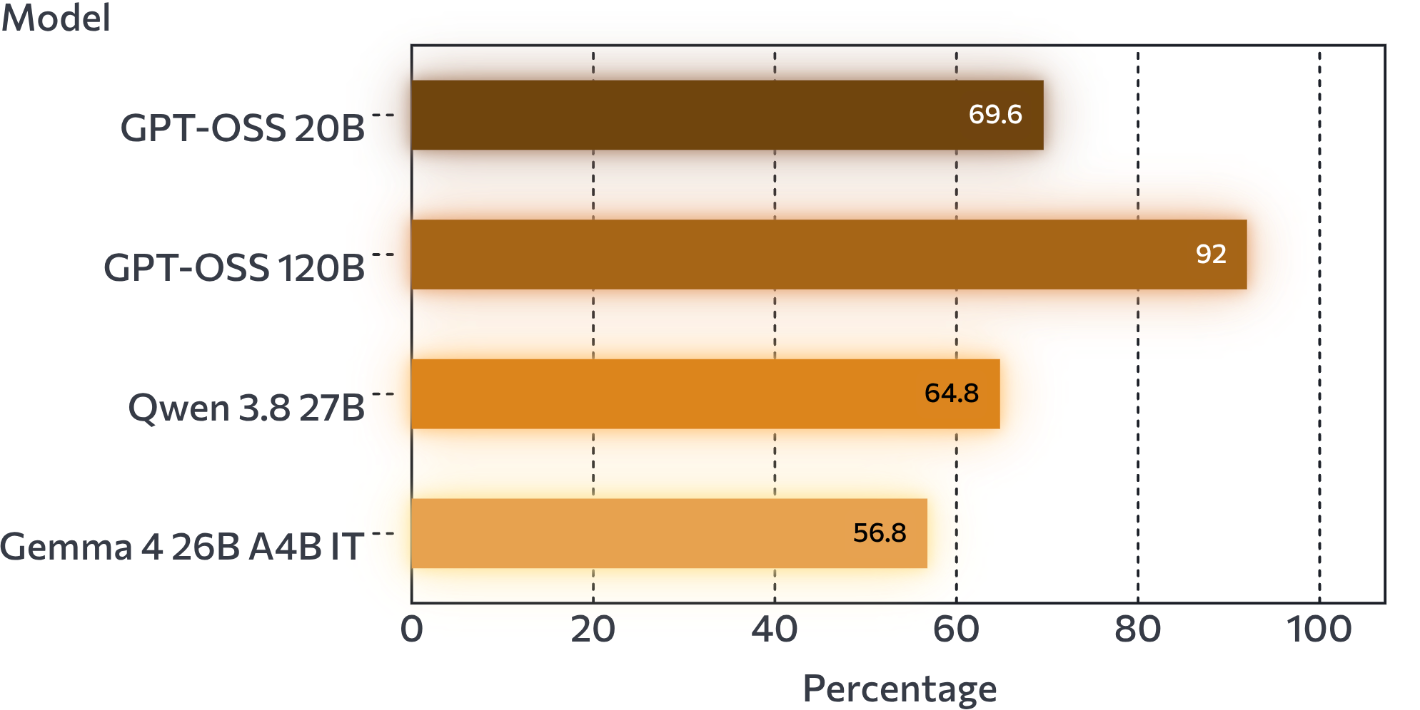
THE COMPARISON
One percentage box makes the comparison easy to scan
score ÷ 125 × 100
Percentage = total score ÷ 125 × 100
All percentages are calculated from illustrative ratings, not measured results, and should be recalculated if the ratings change.

Slide 7
READ THE LOW END
The “very down” area needs evidence, not a broad verdict
One overall total cannot explain why marks were deducted.
01
02
Start
Compare
Start with the lowest-scoring prompts and the exact reasons marks were deducted.
Compare category-level weaknesses, not only the overall total.
03
04
Repeat
Limit
Repeat runs when outputs vary and keep screenshots or logs.
Avoid claiming one model is universally best from a small prompt set.

Slide 8
EVIDENCE BEYOND THE SCORE
Our read combines testing with public review signals
Our own experience
LinkedIn
Record what the team observed while running the shared prompts.
Note recurring practitioner reactions and review themes.
Reddit
YouTube
Compare community-reported strengths, gaps, and edge cases.
Use hands-on demonstrations as qualitative context.
Keep these signals separate from the scored benchmark so opinion does not become a mea.

Slide 9
EVIDENCE CHECKLIST
Ten sources and evidence inputs for the final version
01
Shared 25-prompt evaluation set
02
Team scoring rubric
03
Model response screenshots or logs
04
Model and version records
05
Team’s own testing experience
06
LinkedIn ratings and discussions
07
Reddit ratings and discussions
08
YouTube hands-on reviews
09
Official model documentation and release notes
10
Hackathon brief and submission guidance

Slide 10
FINAL VALIDATION
Validate the scorecard before presenting it as a result
01
02
03
Confirm
Attach
Recalculate
Confirm exact model IDs, versions, settings, and prompt wording.
Attach screenshots or logs and explain each score deduction.
Recalculate totals and percentages from observed results.
The current numbers are illustrative ratings, not verified benchmark results.

